Slide 1
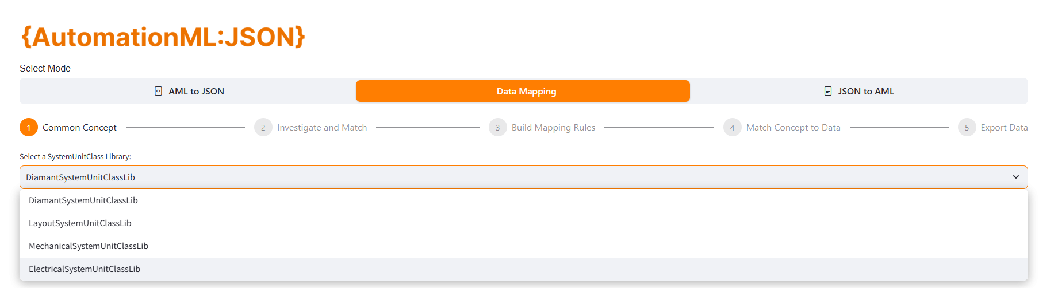

Step 1: Data Mapping - Step 1.1: Common concept
Begin by selecting the domain or system view you wish to work on (e.g., Layout System, Mechanical System, Electrical System).

Slide 2
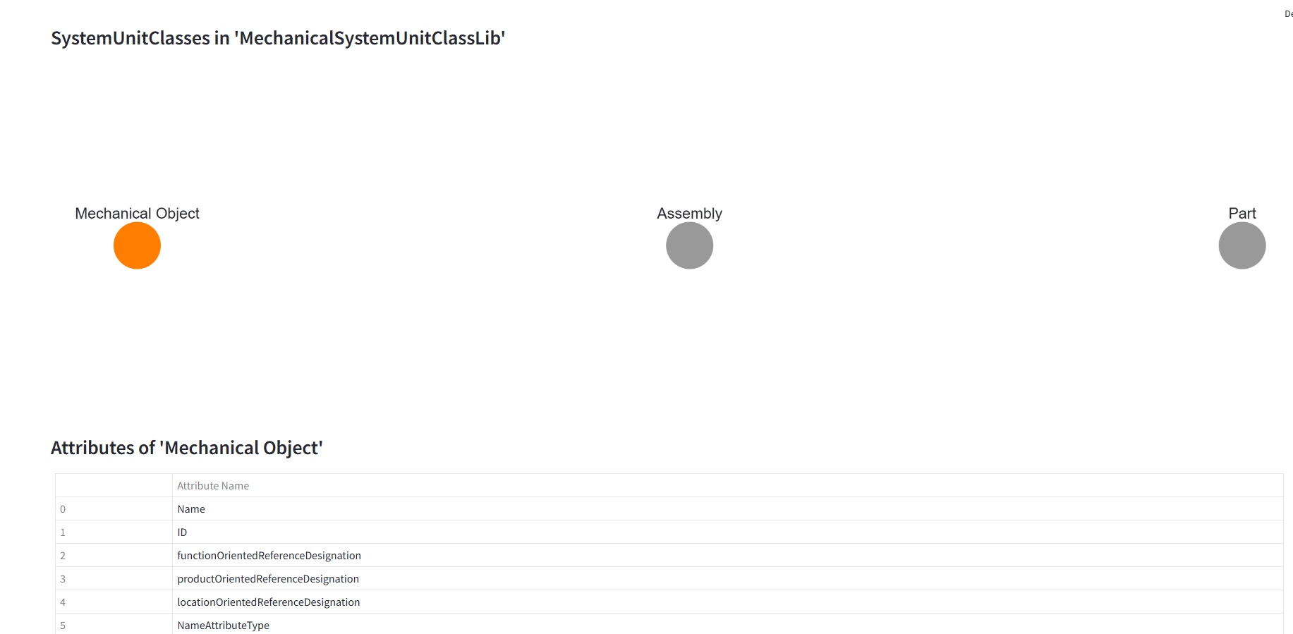
Step 1.1: Common Concept
Classes
Attributes associated with the class
Each domain contains a set of classes. When a class is selected, its associated attributes will be displayed for review and mapping.

Slide 3
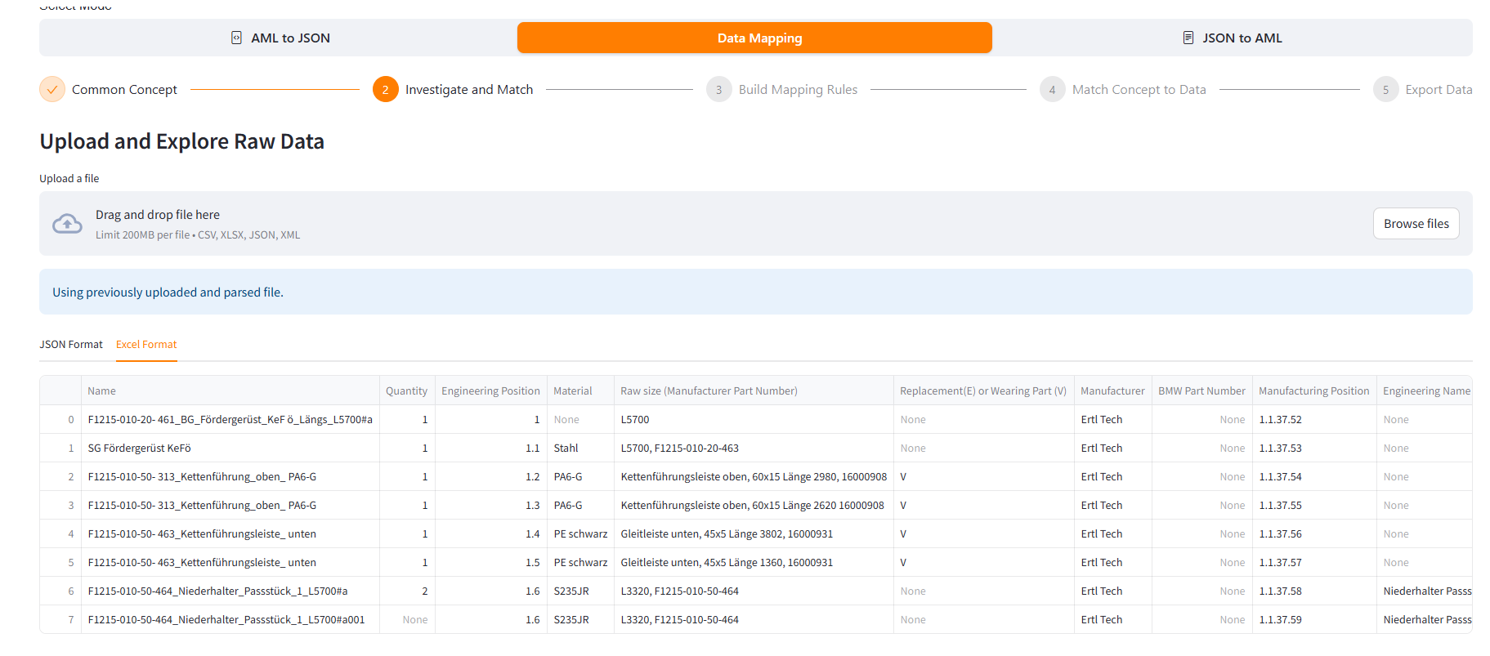
Step 1.2: Investigate and Match
Upload your domain-specific raw data in any of the supported formats (XML, CSV, JSON, or XLSX).

Slide 4
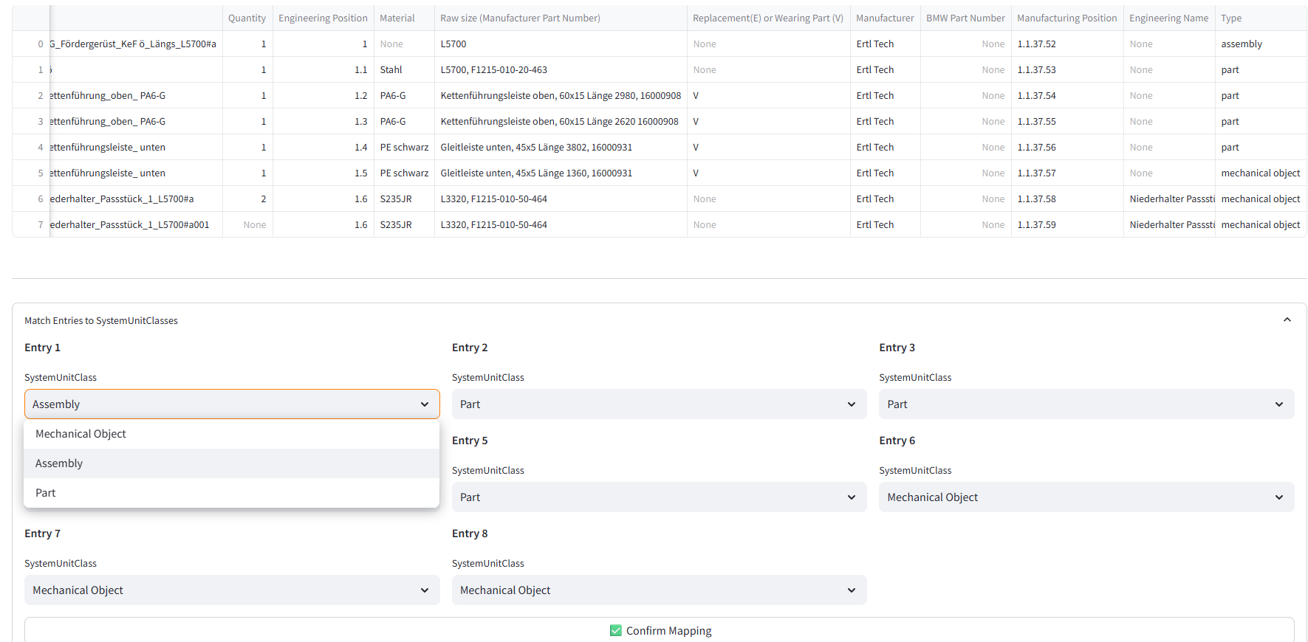
Step 1.2: Investigate and Match
The tool then facilitates the association of individual data entries (rows) with their corresponding System Unit Classes. For example, the mapping can be initiated based on values in a specific attribute such as “Type.”

Slide 5
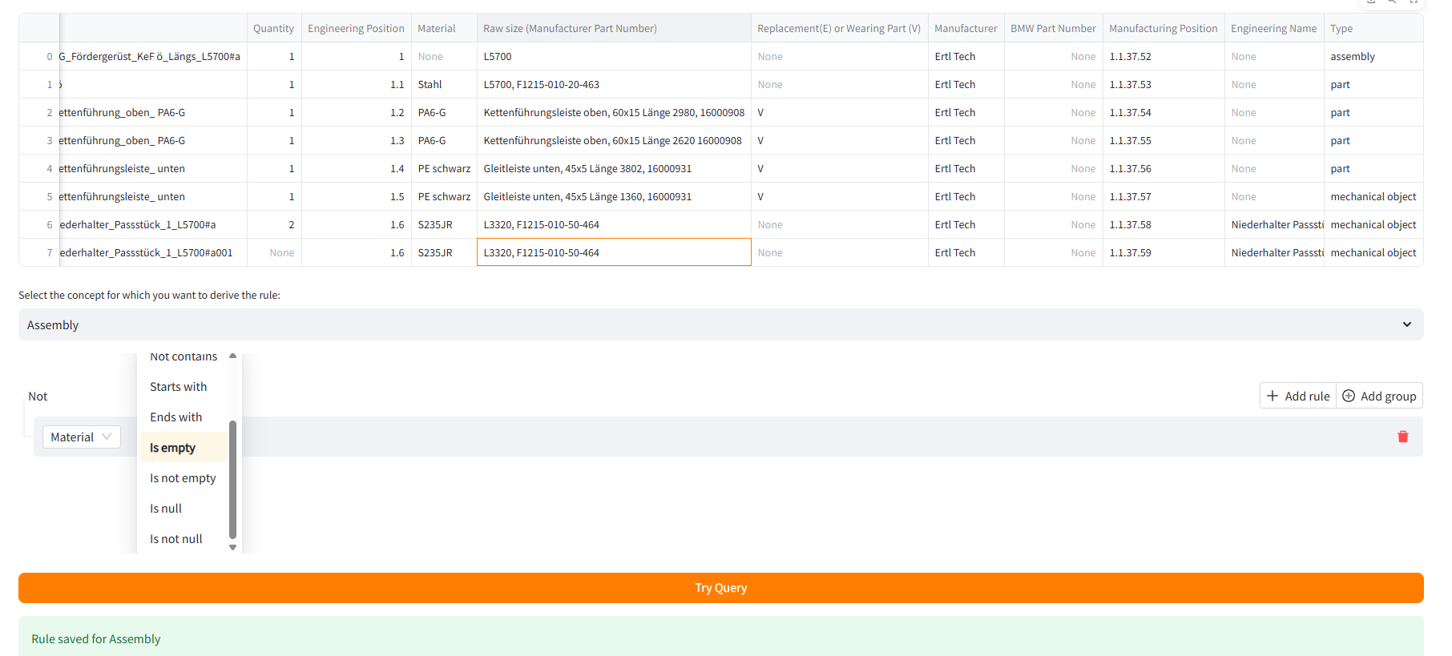
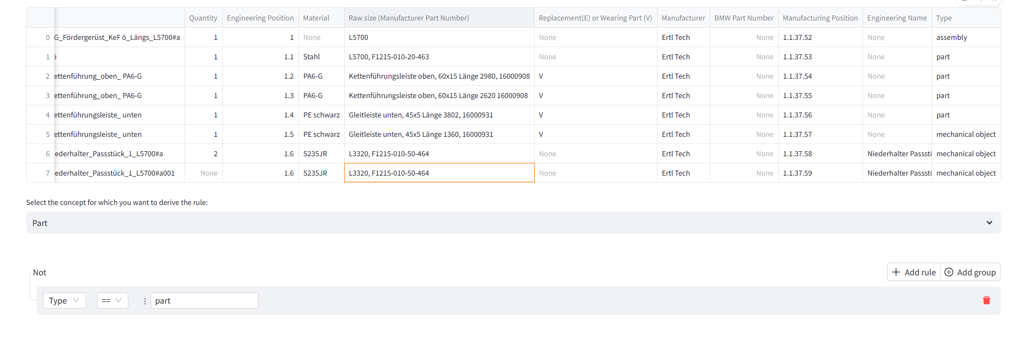
Step 1.3: Build Mapping Rules
To define mapping rules: First select a concept (e.g., Assembly, Part).
Examine the raw data to identify unique characteristics or conditions that distinguish one concept from another.
Ex 1: Assembly concept: If the ‘Material’ field is empty → then the concept is Assembly Rule: If 'Material' is empty → Concept = Assembly
Part concept: If the ‘Type’ attribute equals "part" → then the concept is Part Rule: If 'Type' == 'part' → Concept = Part

Slide 6
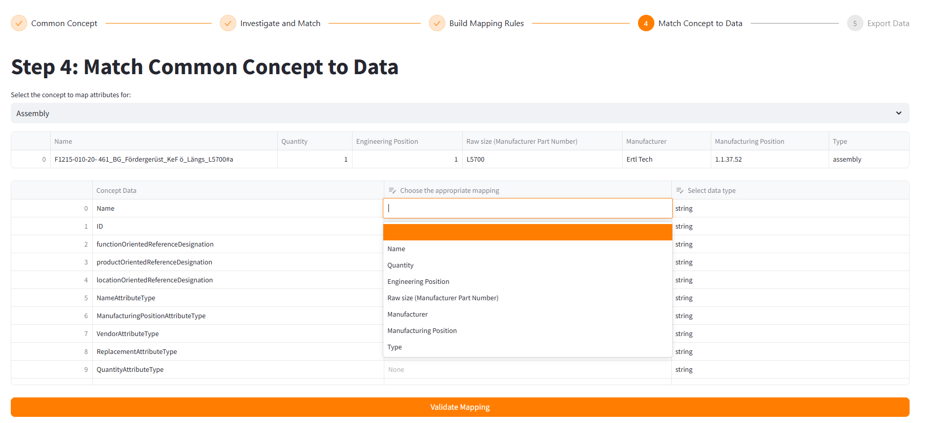
Step 1.4: Match Concept to Data
Select the relevant concept.
In the mapping interface:
The "Concept Data" column shows the attributes expected by the class.
The "Choose the Appropriate Mapping" column allows you to select the corresponding attribute/column from the raw dataset.
This step ensures each concept attribute is accurately linked to its respective data source.

Slide 7
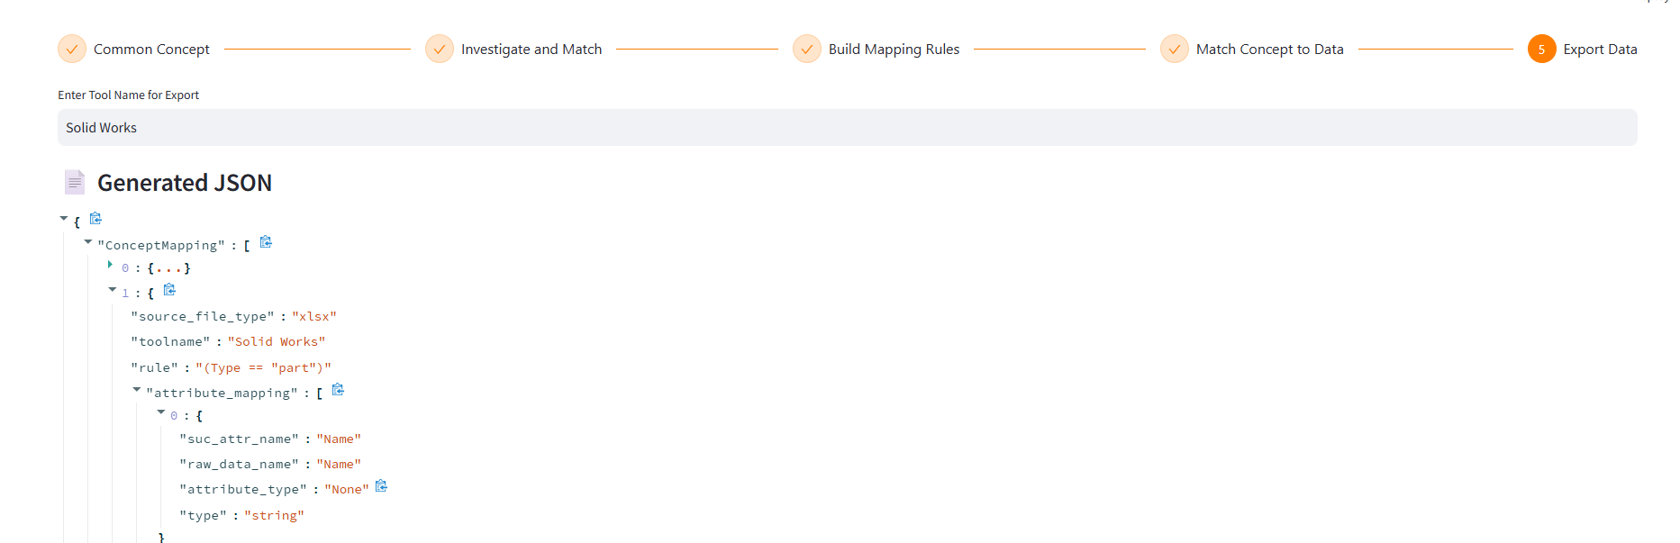
Step 1.5: Export Data
After rules and attribute mappings are completed, export the results as a JSON file. This final output includes all defined rules and data mappings and can be used for instantiating models in AML-compliant systems.

